Slide 1
Carbohydrates, Protein and Lipid Metabolism

Slide 2
Introduction
Nutrition is essential to your performance during all types of exercise. As an athlete, the foods consumed in your diet are used to provide the body with enough energy and specific nutrients to fuel an activity and maximize performance. Athletes have different nutritional needs than the general population in order to support their vigorous activity levels in both practice and competition.

Slide 3
ENERGY NEEDS
To determine an athlete’s nutritional needs, it is important to revisit the concept of energy metabolism. Energy intake is the foundation of an athlete’s diet, because it supports optimal body functions, affects intake of macronutrients and micronutrients, and assists in maintaining body composition. Energy needs for athletes increase depending on their energy expenditure. The amount of energy expended during physical activity is contingent on the intensity, duration, and frequency of the exercise. Competitive athletes may need 3,000 to over 5,000 calories daily compared to a typical inactive individual who needs about 2,000 calories per day. Energy needs are also affected by an individual’s sex, age, and weight.

Slide 4
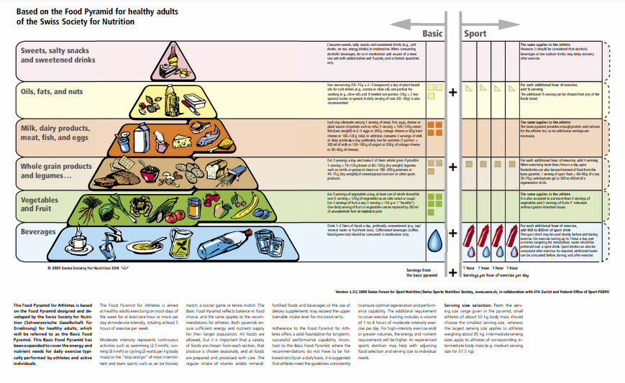
Food pyramid for athletes

Slide 5
MACRONUTRIENT NEEDS
The composition of macronutrients in the diet is a key factor in maximizing performance for athletes. As discussed carbohydrates, fat, and protein can all be utilized for energy production during exercise, though the amount utilized of each nutrient varies depending on the intensity and duration of the exercise.

Slide 6
Carbohydrates
Carbohydrates are an important fuel source for the brain and muscle during exercise. Carbohydrate storage in the liver and muscle is relatively limited, and therefore it is important for athletes to regularly consume enough carbohydrates from their diet. Carbohydrate needs should increase about 3-10 g/kg/day depending on the athlete’s type and level of training and competition

Slide 7
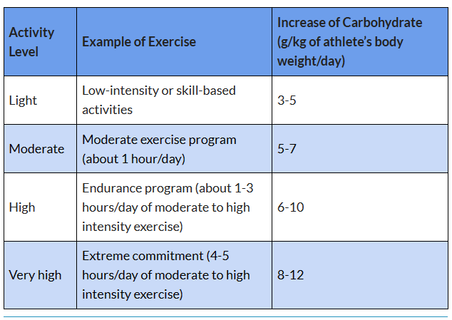

Slide 8
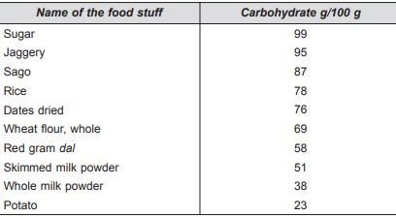
Sources
In India more than two thirds of food eaten is carbohydrate. The main sources of carbohydrate in the diet are all cereals, pulses, roots and tubers. Foods containing sugars like cane and beet also contribute to carbohydrate.

Slide 9
METABOLISM
Metabolism involves all those processes by which the nutrients are used for energy. Direct utilisation: Glucose can be utilised by all the tissues of the body. Glucose should be made accessible to all the cells of the body as the major source of energy. Although fats can also be oxidised to release energy, certain cells, especially the nerve cells and brain tissues cannot function without the availability of glucose from carbohydrate. Glucose undergoes oxidation with the help of the enzymes in the body, to yield carbondi-oxide, water and heat, which is captured in the high energy chemical bonds of specified compounds like Adenosine Tri Phosphate (ATP), which in turn can be enzymatically broken down to release the useful energy, as and when the cells need it. Glucose is broken down in several steps to two molecules of pyruvate which in turn is converted to acetyl Coenzyme A, in the process releasing a small amount of ATP. Next, acetyl Co A enters the TCA Cycle which also involves a series of reactions to release carbon-dioxide, and hydrogen atoms which enter the electron transport system to release ATP. The complete oxidation of one molecule of glucose produces 36 ATP molecules, 6 molecules of CO2 and 6 molecules of H2O

Slide 10
Conversion into glycogen: Whenever more carbohydrate is supplied in the diet than is needed immediately for energy, both the muscle and liver synthesise glycogen from the extraglucose. The body stores only a limited amount of glycogen. The liver glycogen stores are quickly converted to glucose to be used for energy. Muscle glycogen, however, is used only to supply to muscle with energy via glucose and does not affect blood glucose levels.About 150 g of glycogen is stored in muscle, this amount can be increased five fold with physical training. The glycogen store in human liver in about 90 g and is involved in the hormonal control of blood sugar. The liver has glycogen stores for only 12 to 18 hours of fasting; it then becomes glycogen depleted. Glucose occurs in concentrations of up to 6 per cent of liver mass but only 1 per cent of muscle. Since muscle mass is much greater, that is represents 3 to 4 times as much glycogen as in the liver. Muscle glycogen is mainly used by the muscle, but liver glycogen is for storage, export and the maintenance of blood glucose.

Slide 11
Conversion into fat: Steady excess intake of the carbohydrate through the diet, is turned into fat and deposited in the adipose tissues of the body. Major nutrient for energy support in exercise is carbohydrate. When carbohydrate is consumed, blood glucose, level rises which stimulates the release of the hormone insulin. Insulin lowers the blood sugar level after a meal and promotes storage of glucose as muscle and liver glycogen. Insulin brings blood glucose back to normal. If the blood glucose drops too low, another hormone, glucogon steps in to raise it back to normal. This happens naturally in most healthy adults.In glycolysis glucose-6-phosphate is supplied from two sources, such as from circulating blood glucose and stored glycogen in muscle cells and in the liver. Anaerobic glycolysis provides the initial energy source as exercise begins. Even after the aerobic energy system is fully working,it is not possible to meet the body’s energy needs strictly from the oxidation of fatty acids. Even the best conditioned athletes obtain only 60-70 per cent of their needs in endurance exercise from fats. The rest must come from carbohydrate, from blood glucose and from liver and muscle glycogen

Slide 12
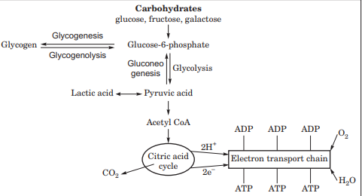

Slide 13
PROTEINS
Dietary protein performs all three functions of nutrients. It is needed for growth, maintenance and repair of body tissue; it regulates key processes within the body and any excess protein can be used as source of energy.About 50 per cent of protein is present in muscle, 20 per cent in bone, 10 per cent in skin and the rest is present in other parts of the body

Slide 14
Nutritional Classification of Proteins
The nutritive value of proteins is determined by the composition of essential amino acids.
From the nutritional point of view, proteins are classified into 3 categories:
1. Complete proteins: These proteins have all the ten essential amino acids in the required
proportion by the human body to promote good growth. e.g., egg albumin, milk casein.
2. Partially incomplete protein: These proteins are partially lacking one or more essential
amino acids and hence can promote moderate growth, e.g., wheat and rice proteins lack
lysine and threonine.
3. Incomplete proteins: These proteins completely lack one or more essential amino acids.
Hence they do not promote growth at all e.g., gelatin lacks trypophan and lysine

Slide 15
METABOLISM
Amino acids circulating in the blood stream are used for tissue synthesis or manufacture of regulatory products or deaminisation. Firstly, body tissues select those amino acids directly from the circulation which are needed for synthesis and replacement, and are arranged to suit The purpose of the tissue. This is a continuous process and the importance of maintaining a constant supply of all the essential amino acids is needed.Secondly, the amino acids may be used in one of the highly specialized body products such as haemoglobin, serum proteins, enzymes, hormones antibodies, purines, creatine, glutathione, carnitine and choline. The liver is the primary site for the synthesis of these products.Finally, any amino acids which are not required for tissue synthesis or for the synthesis of regulatory products are deaminized by the liver. The amino group is broken off and in part is used again for the synthesis of simple amino acids (trans-amination) or is eliminated by the kidney as urea. The rest of the molecule containing carbon, hydrogen and oxygen may be converted into carbohydrate or fat which can be used immediately for energy or stored for future needs. The end products of metabolism of proteins are urea, carbon dioxide, water and energy

Slide 16
Techniques to Quantify Protein and Amino Acid Metabolism
Whole body protein mass could be affected by changes in nutrition and habitual physical activity, which have an impact on gene expression that may lead to shifts in the protein content of the cells (adaptation).Knowledge regarding the regulation of protein metabolism at the whole-bodylevel is based on direct and indirect measurements of protein synthesis and breakdown, and exchange rates of amino acids and amino acid tracers between tissues. The various methods employed to measure the dynamics of protein and amino acid turnover include:
1. Whole-body protein turnover
2. Amino acid incorporation method to measure protein synthesis
3. Arterio-venous balance methods
4. Three compartment model

Slide 17
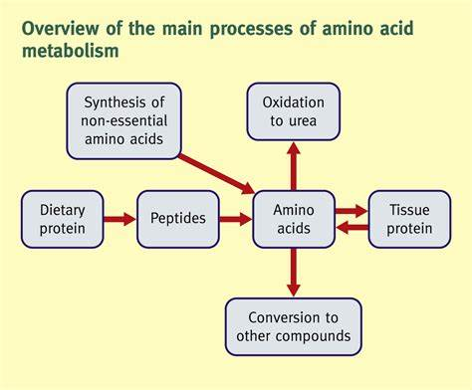

Slide 18
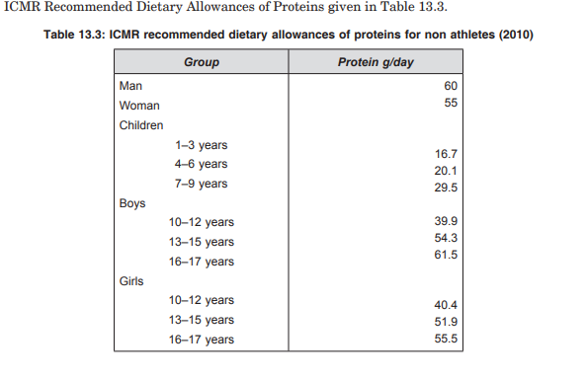
For athletes who train more than 5 hours per week, a protein intake of 1.2-2.0 g/kg bw/day is recommended, depending on the training condition and training goal. The protein intake is not a fixed parameter, but can be flexibly adjusted depending on the training goal, training intensity and training volume.”

Slide 19
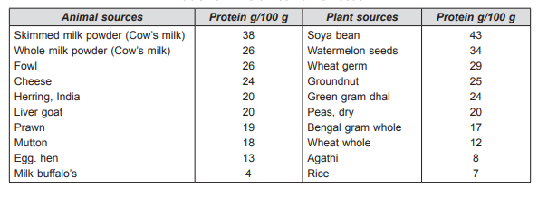
SOURCES

Slide 20
LIPIDS
The term ‘lipid’ is applied to a group of naturally occurring substances characterised by their
insolubility in water and their solubility in such ‘‘fat solvents’’ as ether, chloroform, boiling
alcohol and benzene. Chemically, the lipids are either esters of fatty acids or substances
capable of forming such esters. The word ‘lipid’ is used when discussing the metabolism of
fats in the body whereas the term ‘fats’ is used for the fatty component of foods and diets.
Fats like carbohydrates are composed of the three elements-carbon, hydrogen and oxygen.
The lower amount of oxygen in relation to the other two elements results in fat being a more
concentrated source of energy than carbohydrates.

Slide 21
METABOLISM
Once fatty acids, monoglycerides and other lipids enter tissue cells, they can be metabolised
in one or four different ways.
• They can be used immediately as a source of energy.
• They can be stored as reserve energy supplies within the lipid of the specialised adipose
cells.
• They can become incorporated, as required into the lipid-containing structures of the
cell.
• They can be used as raw materials for the synthesis of a variety of essential compounds
of the body, including cholesterol

Slide 22
Like biological oxidation that release energy, the oxidation of fatty acids proceeds via a series of, transformation known as b-oxidation metabolic pathway. This is because it involves removal of two carbon atoms at a time from the fatty acid chain by breaking the bond between the b and g atoms of a fatty acid until the original fatty acid has been entirely degraded. The two-carbon units become part of acetyl coenzyme A which enters the series of reactions known as the citric acid cycle. This leads to the complete oxidation of the carbon and hydrogen atoms derived from fatty acids to carbon dioxide and water with the release of energy as ATP.Fatty acid oxidation cannot proceed properly if an appropriate amount of carbohydrate oxidation is also not taking place. Deficiency of carbohydrate leads to accumulation of intermediary products, ketone bodies, in the body.Bile micelles (tiny spherical aggregates of lipids and bile salts) then carry the monoglycerides and free fatty acids across what is called the unstirred water layer between the lipid droplets from which they are derived and the membranes of intestinal mucosal cells. This journey is ;ate limiting step in the entire lipid absorption process.

Slide 23
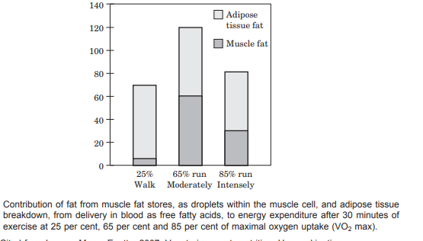

Slide 24
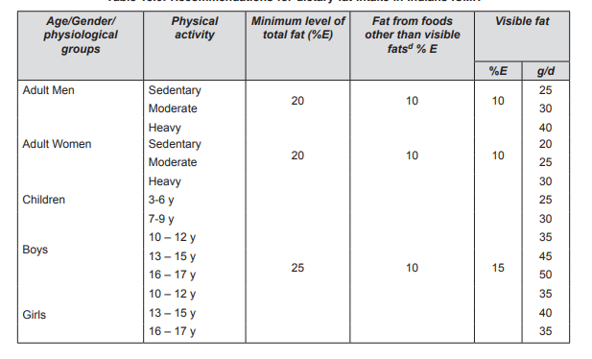
RECOMMEDED DIETARY ALLOWANCES

Slide 25
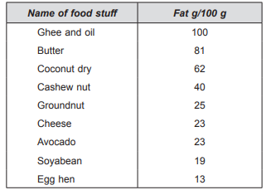
SOURCES

Slide 26
REFERENCES
Exercise physiology ,fitness and sports nutrition (Author:Kalaivani Ashok)
https://openoregon.pressbooks.pub/nutritionscience/chapter/10c-nutrient-needs-athletes/
https://www.nationwidechildrens.org/specialties/sports-medicine/sports-medicine-articles/fueling-and-hydrating-before-during-and-after-exercise

Slide 27


