Slide 1
The Science of Sports Hydration and Thermoregulation

Slide 2

Introduction
Welcome to the Science of Sports Hydration and Thermoregulation. This presentation explores the critical role of hydration and thermoregulation in optimizing athletic performance. We will delve into the latest research and practical strategies for athletes and coaches. Let's get started!

Slide 3
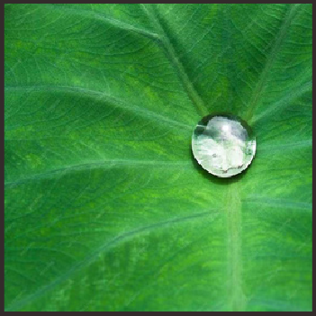
Importance of Hydration
Understanding the impact of hydration on athletic performance is crucial. Proper hydration maintains blood volume, regulates body temperature, and supports nutrient transport. Dehydration can lead to decreased performance, fatigue, and increased risk of injury.

Slide 4

Hydration Guidelines
Optimal hydration involves pre-hydration and ﬂuid replacement during exercise.
Athletes should aim to consume 5-10 ml of water per kilogram of body weight 2-4 hours before exercise, and 150-350 ml every 15-20 minutes during exercise.

Slide 5

Maintaining electrolyte balance is essential for proper muscle function and hydration. Sodium, potassium, and magnesium are key electrolytes that play a critical role in ﬂuid balance and muscle contraction. Imbalance can lead to cramping and decreased performance.

Slide 6
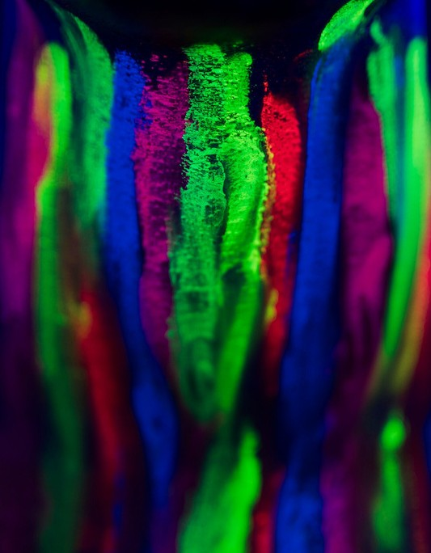
Thermoregulation Mechanisms
The body's thermoregulation mechanisms help maintain a stable core temperature during exercise. These mechanisms include sweating, vasodilation, and heat dissipation. Understanding these processes is vital for optimizing performance in varying environmental conditions.

Slide 7

Heat Stress Management
Managing heat stress is crucial for athletes performing in hot environments.
Strategies such as acclimatization, wearing light and breathable clothing, and taking regular cooling breaks can help mitigate the impact of heat on performance.

Slide 8

Cold Weather Performance
In cold conditions, maintaining body temperature is essential for performance and safety. Proper layering, maintaining dryness, and using heat-retaining gear are key strategies to optimize performance in cold weather.

Slide 9
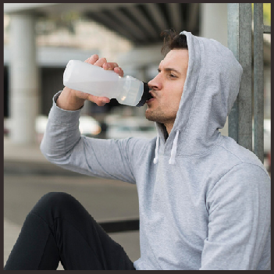
Hydration and Recovery
Post-exercise rehydration is critical for recovery and performance. Consuming ﬂuids rich in electrolytes and carbohydrates helps replenish glycogen stores and supports muscle recovery.
Optimal rehydration accelerates recovery and prepares the body for subsequent training sessions.

Slide 10

Practical Application
Implementing evidence-based hydration and thermoregulation strategies is essential for athletes and coaches. This knowledge can enhance performance, reduce the risk of heat-related illnesses, and optimize training adaptations.
Practical application is key to achieving peak athletic performance.

Slide 11

Performance Optimization
The integration of hydration and thermoregulation science into training and competition can lead to signiﬁcant performance gains. Athletes who prioritize proper hydration and temperature regulation have a competitive edge, enabling them to perform at their best in any environment.

Slide 12

Q&A Session
Thank you for your attention. Now, we will open the ﬂoor for a question and answer session. Feel free to ask any questions related to sports hydration and thermoregulation. Let's engage in a fruitful discussion!

Slide 13

Conclusion
In conclusion, the science of sports hydration and thermoregulation is a critical component of athletic performance. By understanding and implementing evidence-based strategies, athletes can optimize their performance, reduce the risk of heat-related illnesses, and achieve peak results. Thank you for joining us today!

