Slide 1
NUTRITION IN DIFFERENT TYPES OF SPORTS - team, endurance, combat sports

Slide 2
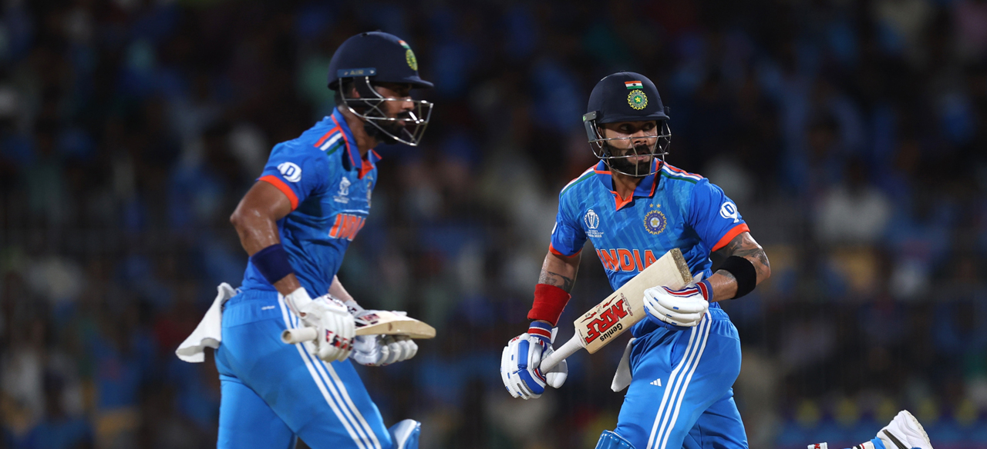
TEAM SPORTS
Team sports are organized athletic activities in which groups of individuals
come together to compete against each other. These sports emphasize cooperation,communication, and collective effort among team members. Here are some key aspects of team sports:_x0000_ _x0000_
Common Examples:
Examples of team sports include soccer,basketball, football, hockey, volleyball,
rugby, and many others.

Slide 3
ENDURANCE SPORTS
Endurance sports are athletic activities
that require participants to sustain
prolonged, continuous efforts. These
sports demand a high level of
cardiovascular fitness, stamina, and
mental resilience. Here are some
common examples of endurance sports:
Running
Cycling
Swimming
Triathlon
Race walking
Distance hiking

Slide 4
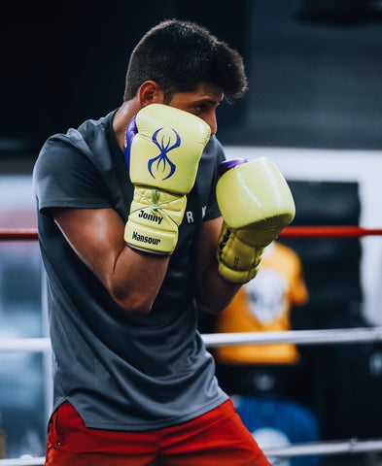
COMBAT SPORTS
Combat sports are a category of athletic activities that involve physical contact between participants.
These sports often emphasize both striking and
grappling techniques and may take place in a
controlled environment such as a ring or a cage.
Here are some common examples of combat sports:
Boxing
Mixed martial arts
Judo
Wrestling
Kick boxing
Fencing

Slide 5
PHYSICAL DEMANDS IN DIFFERENT TYPES OF SPORTS

Slide 6
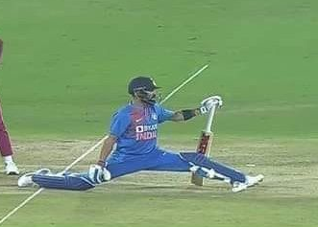
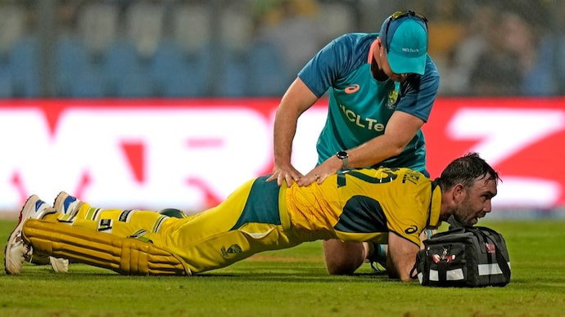
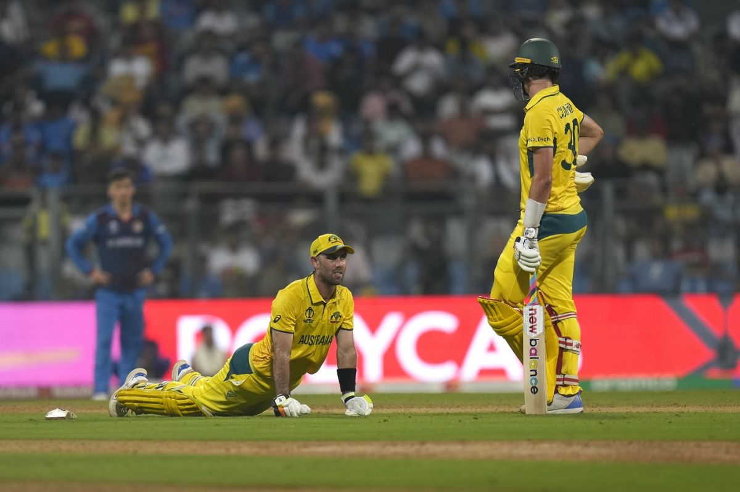
common physical demands of team sports:
Cardiovascular Endurance:
Continuous movement and frequent changes in pace demand strong cardiovascular endurance to sustain performance throughout the game.

Slide 7
Coordination and Balance:
Precise movements, hand-eye coordination, and balance are vital for ball control, accurate passing, and effective defensive maneuvers.
Flexibility
Dynamic movements and sudden changes in direction require flexibility to prevent injuries and enhance performance.
Tactical Intelligence:
Understanding and implementing strategic plays, adapting to opponents, and making quick decisions are essential aspects of team sports.
Recovery Skills:
Rapid recovery between plays and during breaks is necessary to maintain optimal performance throughout a game or match.
Mental Toughness:
Resilience, focus, and the ability to handle pressure are essential for overcoming challenges and making effective decisions in competitive situations.

Slide 8
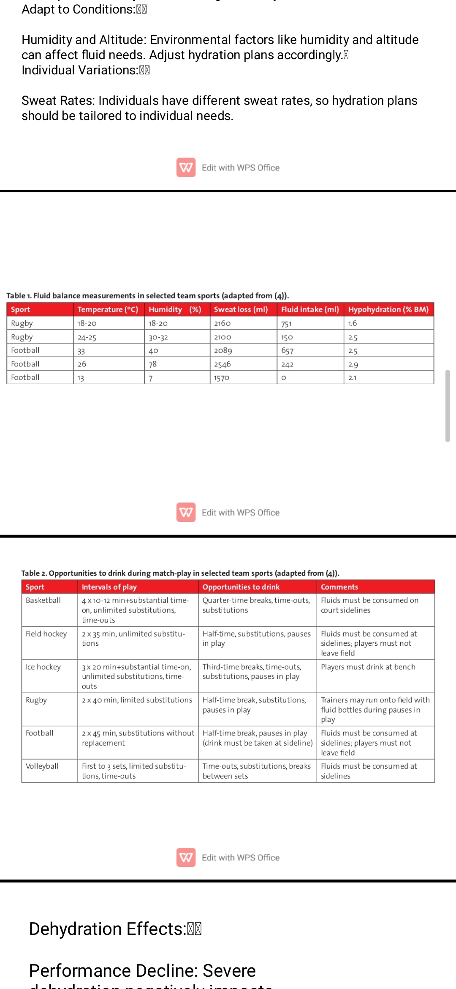

Slide 9
Injury Prevention:
Agility, proper technique, and conditioning contribute to injury prevention, as team sports often involve physical contact and high-intensity movements.
Common physical demands for endurance sports:
Endurance sports like long-distance running, cycling, swimming, and triathlons require significant physical demands. They challenge cardiovascular fitness, muscular endurance, mental resilience, and efficient energy utilization. Athletes in endurance sports often have high aerobic capacity, strong leg muscles, mental stamina, and the ability to sustain prolonged activity while managing fatigue. Training focuses on building endurance, improving oxygen uptake, enhancing muscular strength and flexibility, and honing mental strategies to push through physical barriers. Nutrition, hydration, and recovery also play crucial roles in supporting the demands of endurance sports.

Slide 10
Cardiovascular Conditioning: Building a strong aerobic base through activities like long runs,rides, or swims._x0000_ _x0000_
Nutrition and Hydration: Proper fueling and hydration strategies to sustain energy levels over extended periods._x0000_ _x0000_
Mental Resilience: Developing mental toughness to push through fatigue and maintain focus during prolonged efforts._x0000_ _x0000_
Recovery: Adequate rest and recovery are crucial to prevent overtraining and enhance long-term performance.
Common physical demands in combat sports
Technical Skill Development: Mastery of specific striking, grappling, and defensive techniques.
Physical Conditioning: Endurance, strength, and flexibility are crucial for success in combat sports.

Slide 11
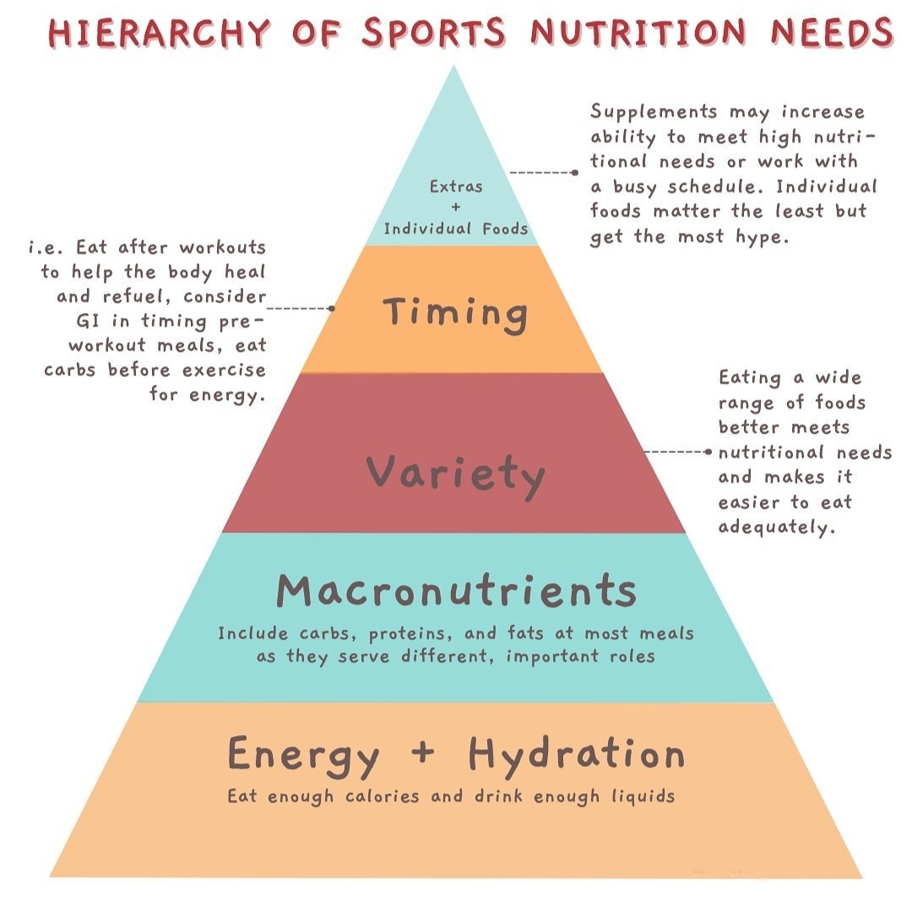

Slide 12
Strategy and Tactics: Understanding how to utilize techniques effectively and adapt to opponents' styles._
Mental Toughness: Combat sports require mental resilience and the ability to stay focused under pressure
Weight Management: Many combat sports have weight classes, and athletes often engage in weight cutting to compete in a specific division.

Slide 13
NEEDS OF PROTEIN, CARBOHYDRATES, FATS IN DIFFERENT TYPES OF SPORTS

Slide 14
TEAM SPORTS
Protein:_
Role: Essential for muscle repair, recovery, and overall growth._x0000_
Recommended Intake: Approximately 1.2 to 2.0 grams of protein per kilogram of body weight per day._
Timing: Distribute protein intake evenly throughout the day and include protein-rich foods in post-training or post-game meals.
Carbohydrates:
Role: Primary energy source for high-intensity activities in team sport
Recommended Intake: 5 to 10 grams of carbohydrates per kilogram of body weight per day, depending on training intensity and duration.
Timing: Emphasize carbohydrates in pre-game meals, include them in snacks during longer events, and replenish glycogen stores with
carbohydrates post-exercise.

Slide 15
Fats:
Role: Provide a secondary energy source and support overall health.
_Recommended Intake: 20-35% of total daily caloric intake should come
from fats._
Types of Fats: Emphasize healthy fats, including sources like avocados,
nuts, seeds, and olive oil. Limit saturated and trans fats.
Planned drinking, also known as strategic hydration, is a crucial aspect of nutrition in team sports. Proper hydration ensures that athletes maintain performance, prevent dehydration, and support overall well-being.
PRE- EVENT HYDRATION
Start hydrating well before the game or training session.Consume fluids in the hours leading up to the event to ensure that the body is adequately
hydrated. Urine color can be a useful indicator—pale yellow is generally a sign of good hydration

Slide 16
DURING -EVENT HYDRATION
Take regular breaks to consume fluids during the game or training. Water is generally sufficient for shorter events, while sports drinks containing electrolytes may be beneficial for longer or more intense activities to replace lost salts.
Sweat Rates: Individuals have different sweat rates, so hydration plans should be tailored to individual needs.
Sweat Losses: For activities with significant sweating consider beverages that contain electrolytes (sodium, potassium, etc.) to replace what is lost through sweat
ENDURE SPORTS
Carbohydrates:
Role: Primary fuel source for endurance activities, maintaining glycogen stores and sustaining energy levels._x0000_
Recommended Intake: 6 to 10 grams of carbohydrates per kilogram of body weight per day, depending on training intensity and duration.

Slide 17
Protein:_
Role: Essential for muscle repair and recovery, especially after long-duration activities.
Recommended Intake: Approximately 1.2 to 2.0 grams of protein per kilogram of body weight per day._
Timing: Consume protein-rich meals and snacks throughout the day, with a particular emphasis on post-exercise nutrition to support recovery.
Fats:_
Role: Serve as an additional energy source, particularly during low to moderate-intensity exercise and in prolonged endurance events._x0000_
Recommended Intake: 20-35% of total daily caloric intake should come from fats, with an emphasis on healthy fats._
Types of Fats: Include sources of healthy fats such as avocados, nuts, seeds, olive oil, and fatty fish.

Slide 18
Hydration:
Proper hydration is critical for endurance athletes to maintain performance and prevent dehydration._x0000_Guidelines suggest 30-60 grams of carbohydrates per hour during prolonged exercise, along with adequate fluid to prevent dehydration.
Sweat Losses: Endurance athletes, especially those in hot conditions, may need to replace electrolytes lost through sweat. Consider sports drinks or electrolyte supplements
COMBAT SPORTS
Protein:_
Role: Essential for muscle repair, recovery, and maintenance.__
Recommended Intake: Approximately 1.2 to 2.0 grams of protein per kilogram of body weight per day._Timing: Distribute protein intake throughout the day, with a focus on post-training or post-competition meals to support recovery

Slide 19
Carbohydrates:
Role: Primary energy source for highintensity activities,especially during
training sessions and competitions.
Recommended Intake: 5 to 7 grams of carbohydrates per kilogram of body
weight per day for moderate training higher for athletes with intense training
schedules
Fats:_
Role: Provide sustained energy, support hormone production, and aid in nutrient absorption.
Recommended Intake: 20-35% of total daily caloric intake should come from fats.
Proper hydration is critical for performance and recovery in combat sports.
Fluid Intake: Hydrate before, during, and after training or competition. Individual fluid needs vary, and athletes monitor their urine color and body weight to assess hydration status.

Slide 20
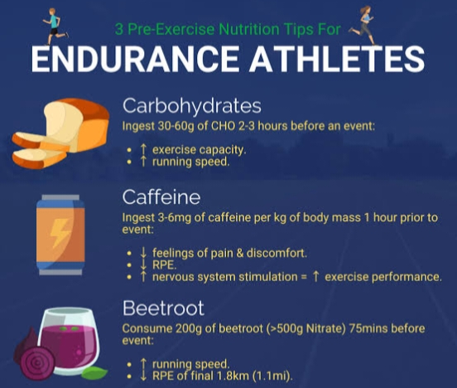
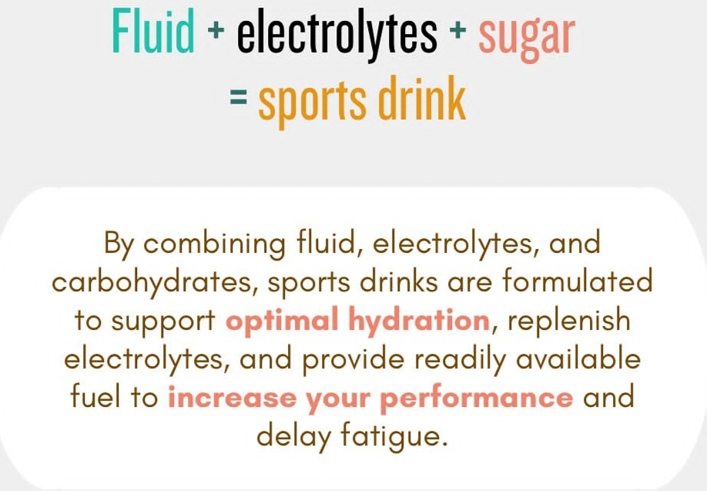
Sweat Losses: Combat sports, especially those conducted in hot environments, may lead to significant electrolyte losses. Consider sports drinks or electrolyte supplements to maintain balance.

Slide 21
NEGATIVE EFFECTS OF WEIGHT CUTTING, REFUELING ,DEHYDRATION

Slide 22
WEIGHT CUTTING
Negative is the likelihood of remaining dehydrated as this will decrease athletic performance. As many as 34% of sport athletes are dehydrated when they compete. This results in less total body water, reduced blood volume, and reduced total hemoglobin volume. Due to combat sports requiring the athletes to be in excellent aerobic condition, a reduction in oxygenation through less hemoglobin will negatively impact their ability to perform. Reduced glycogen stores is another side effect of weight cutting
Replenished glycogen stores are important as they provide energy for the athlete and will negatively impact performance if left empty.
The last con of weight cutting is that it can be dangerous if performed incorrectly as kidney damage may occur. During the RWL phase, Creatinine and Blood Urea Nitrogen or BUN levels are negatively impacted. Plus, if an issue occurs where the body’s core temperature rises too much heat stroke can occur and even lead to fatalities

Slide 23
Weight cutting is mentally and emotionally taxing and negative psychological impacts on the athlete at a time when they need to be focused on the competition instead of dangerous weight cutting practices.
REFUELING
Fuel During Exercise
Eating during training that is longer than 90 minutes is also a good idea, especially if it is a particularly intense session. These carbohydrates will enter the bloodstream and the muscle, maintaining your blood sugar and giving the muscle a continuous source of energy.
If you fail to eat after about two hours of intense aerobic exercise, your performance will start to gradually decline until the dreaded bonk occurs. When blood sugar drops, your body will burn through its remaining muscle glycogen rapidly. Then, a few nasty things will happen:

Slide 24
* Muscular performance will decline. Your power/pace will rapidly decrease.
*Lowered blood sugar will impair decision making and technique. A particularly big issue during competition.
*Muscle breakdown increases.
*Rate of perceived exertion will dramatically increase.
The longer and harder the session is, the more carbohydrates you need. Consuming plenty of calories during training will also help you to meet caloric requirements for the day and enhance recovery for the next bout of exercise.
Fueling After Exercise
Finally, remember that training is a catabolic process that causes damage to your body. Providing plenty of calories immediately after training will give your body the energy it needs to begin the repair process quickly and help you recover faster.
.

Slide 25
Carbohydrates and proteins signal hormones in your body that will tell it to begin the repair process. Without a post-workout meal, this response will be impaired; you will struggle to fully recover. Your muscles will also be depleted of glycogen. Remember that during the recovery window immediately following training, you will be able to synthesize new muscle glycogen more effectively.
DEHYDRATION
If your endurance time is 121 minutes, dehydration can drop your endurance time down to 55 minutes.1 There are a variety of effects that come into play when your body is dehydrated that directly impacts athletic performance. Some effects of dehydration include a reduction in blood volume, decreased skin blood flow, decreased sweat rate, increased core temperature, and an increased rate of muscle glycogen use.

Slide 26
if your endurance time is 121 minutes, dehydration can drop your endurance time down to 55 minutes.1 There are a variety of effects that come into play when your body is dehydrated that directly impacts athletic performance. Some effects of dehydration include a reduction in blood volume, decreased skin blood flow, decreased sweat rate, increased core temperature, and an increased rate of muscle glycogen use.1 All of these factors negatively impact your ability to perform at your highest level.
Dehydration can not only impact your performance physically but it can also negatively impact your mental game. Your cognitive performance is just as important as your physical performance. Dehydration can lead to slower reaction times, increased fatigue, and poor concentration. The climate plays a role in hydration levels as well. Shoutout to the intense Arizona heat for providing even more reasons to stay properly hydrated all year long.

Slide 27
THANKYOU

