Slide 1

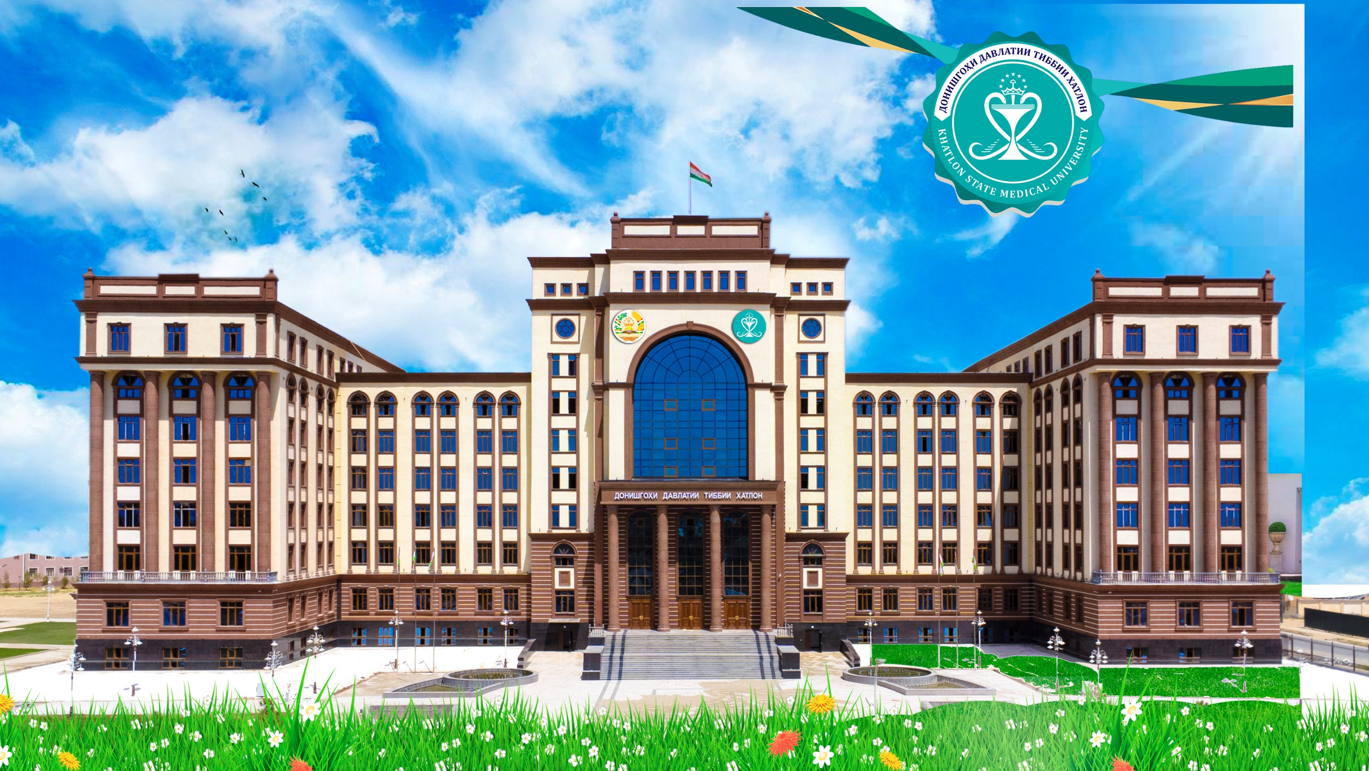
STRATEGY FOR SUSTAINABLE DEVELOPMENT OF SCHOOL MEALS IN THE REPUBLIC OF TAJIKISTAN FOR 2017-2027
.

Slide 2
Fast Facts about Tajikistan
• Territory – 143.1 m2
• Population – 8.74 mln
• 34% of population (2.94 million) – children under 14 yrs.
• Chronic malnutrition rate - 26% of children under 5 yrs.
• Acute malnutrition (hypotrophy) - 10%.
• Economic losses due to malnutrition - US$ 41 million per annum.
• 40% of school-aged children diseases caused by malnutrition.

Slide 3
School Feeding Programme in Tajikistan
• Reaches 395 000 schoolchildren every year;
• Pupils of 1 – 4 grades get daily warm food (469 kcal);
• Covers 2000 rural schools in 52 districts;
• Operating since 1999.
• Annual WFP Budget contribution - 8,5 млн. долл
• Contribution of stakeholders in 2016-17 year. WFP - 69%, Government - 17%.

Slide 4
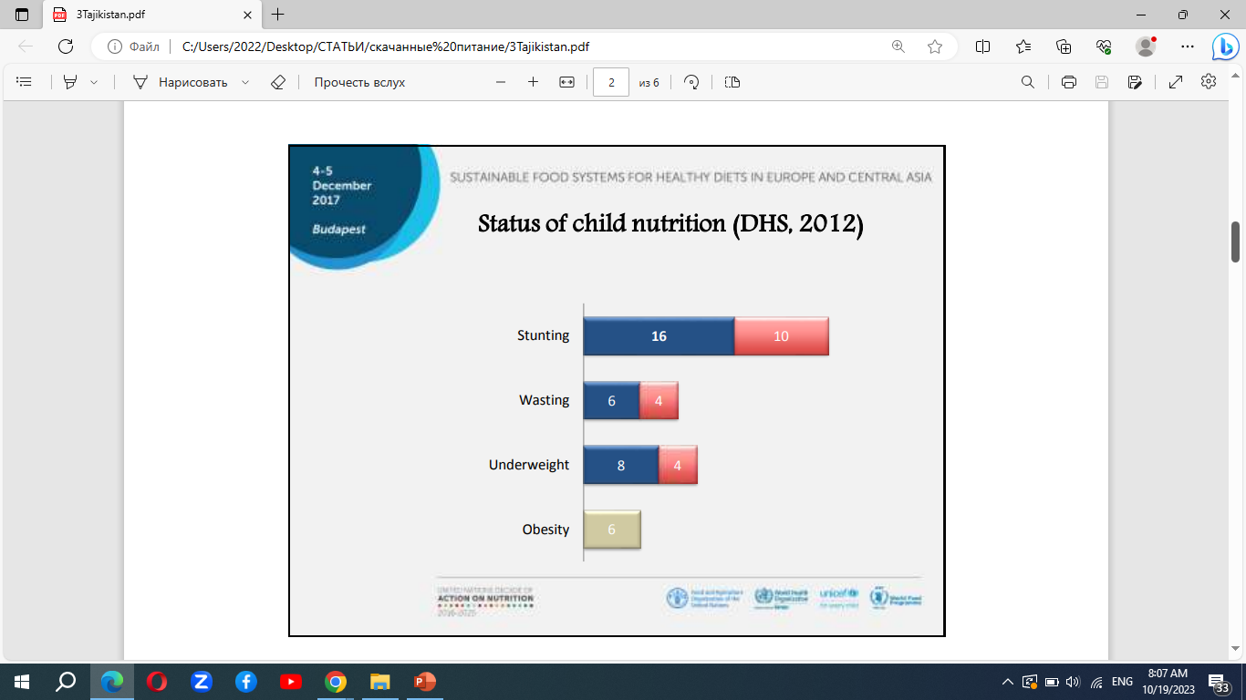
Status of child nutrition (DHS, 2012)

Slide 5
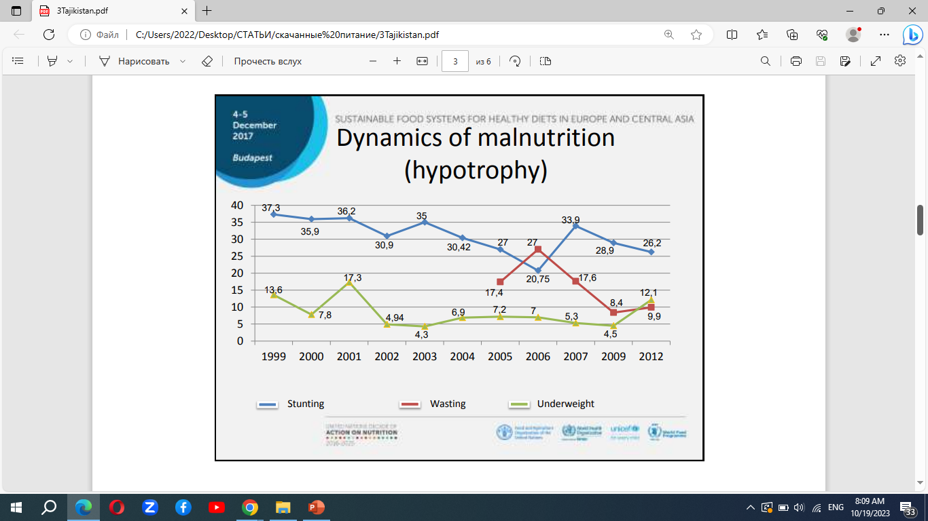
Dynamics of malnutrition (hypotrophy)

Slide 6
Policy documents on School Meals
• Strategy on Nutrition and physical activity in Tajikistan for 2014-2024 (2014);
• Concept on Improvement of School Meals (2015).
• Eventually, an Inter-Ministerial Coordination Council was established.
• The Council elaborated the Strategy for Sustainable Development of School Meals for 2017-2027.
• The Strategy has been approved in September 2017.

Slide 7
Objectives of the School Meals Strategy 2017-2027:
• preservation and improving the health and enhancement of learning performance of schoolchildren through sustainable development of school meals;
• ensuring a stable financing and planning;
• public participation and parents engagement towards development of school meal

Slide 8
Implementation Stages of Strategy 2017- 2027:
• First stage covers the period of 2017-2018. - Development of legal and regulatory framework for the organization of school meals; - Establishment of effective organizational and management infrastructure; - Development of pilot projects to implement school meals models, determination of the conditions and cost for their implementation; - Human resource development-.
• Second stage 2019-2020; - Implementation of school meals models within the developed pilot projects ; - Selection of the most promising school meals models and related solutions.
• Third stage 2021-2026. - Implementation of the activities of the National School Meals Programme in accordance with the approved work schedules; -

Slide 9
Extension of the school meals system to all regions of the Republic of Tajikistan;
Gradual transition to independent implementation of the school meals programs funded by the state udget and other sources.

Slide 10
Expected results of the Strategy 2017-2027
• improved nutrition of schoolchildren;
• improved attendance;
• decreasing diseases among children;
• market sourcing for agricultural food products;
• technological advancement and restricting of the sector;
• enhancement of the production and processing sectors;
• improved resilience to internal and external shocks of food security

Slide 11
Policy recommendations and next steps:
• Based on School Meals Strategy 2017-2027, to shift to full financing of school meals for primary grades students through designing a new mechanism of funding schools.
• To design a Regulation for monitoring of security of food commodities and public health.
• To plan financing for expansion of state programmes on nutrition;
• To elaborate an Action Pan on nutrition in the frame of Global movement on nutrition (SUN).

Slide 12
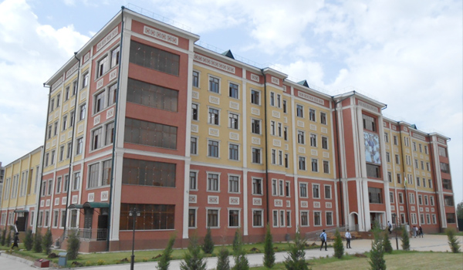
Thank you for your attention

